Slide 1
Digital Partnering Operating Model
Presented by: Oliver Christie Date: 13th May 2022

Slide 2
Summary
Merger has accelerated the need coordinate our digital messaging
The strategic goal being to:
enable ICS digital investment to make best use of National offerings in their Digital Plans,
utilise scarce National support in a transparent and coordinated manner to best enable local transformation priorities
provide the Transformation Directorate with the local business intelligence and systems data to drive the strategic design and direction of National Services.
Additional outcomes being:
reduction in unnecessary and unsustainable information flows
reduction in the local engagement effort and burden of information requests being placed on the CIO Digital community
improved customer satisfaction of the Digital Transformation agenda through demonstrated understanding, collaboration and transparency
Notes:
The merger of National Bodies, expansion of the National digital portfolio and increased requirements to deliver benefits at pace, have accelerated the need to coordinate our digital messaging and support offerings to frontline Digital Leaders. The purpose of this paper is to seek agreement for the establishment of a Digital Partnering Operating Model. The Model will coordinate the alignment of digital communications, programme roadmaps and National priorities for Chief Information Officers (CIO) and Integrated Care System (ICS) Digital Leaders.
The strategic goal being to:
enable ICS digital investment to make best use of National offerings in their Digital Plans,
utilise scarce National support in a transparent and coordinated manner to best enable local transformation priorities
provide the Transformation Directorate with the local business intelligence and systems data to drive the strategic design and direction of National Services.
Additional outcomes being:
reduction in unnecessary and unsustainable information flows
reduction in the local engagement effort and burden of information requests being placed on the CIO Digital community
improved customer satisfaction of the Digital Transformation agenda through demonstrated understanding, collaboration and transparency
Close Digital Partnering aims to shift the current system perception of providing National Solutions to meet National priorities, to aligning National Solutions that support Transformation in delivering local patient outcomes.

Slide 3
Background
NHSx 2021 ICS Deep Dive Review
Finding 1: Our national priorities for ICSs are not well understood and risk being shaped without a clear mechanism for regional and local input
Finding 2: We need to speak as the digital transformation directorate with one voice.
Finding 3: Frontline and programme leads struggle to make sense of the relative functions of and relationship between the centre, ICS and region.
Finding 4: Programmes and ICSs lack the required resource, assets and tools to maximise the impact of their programmes
Recommendation 1: We define and promote our national objectives and develop tailored support offers with tangible and sequenced objectives, based on specific ICS needs, maturity and development stage.
Recommendation 2: We will establish an ICS “Engagement Function” for the digital part of the Transformation Directorate, with clear leads for ICSs to approach in the first instance. We will design the function with the right remit, culture and individuals to jointly serve and feel owned by both ICSs and the centre.
Recommendation 3: We will define the role of the regions, working closely with Mark Cubbon on his review of NHSEI’s operating model to ensure alignment.
Recommendation 4: We will develop ICS-level Digital Implementation Teams more widely to provide on-the-ground specialist skills. We will work with ICS-facing programmes to best utilise and top-up these teams as needed.
Notes:
NHSx’s Implementation Unit undertook an ICS Deep Dive in 2021 to identify the issues ICSs are facing with the current digital engagement and delivery across Arms Length Bodies. The report identified 4 key findings, and made 4 significant recommendations that were endorsed by the NHSx Management Team
Finding 1: Our national priorities for ICSs are not well understood and risk being shaped without a clear mechanism for regional and local input
Finding 2: We need to speak as the digital transformation directorate with one voice. And preferably that includes any digital agendas across the system
Finding 3: Frontline and programme leads struggle to make sense of the relative functions of and relationship between the centre, ICS and region.
Finding 4: Programmes and ICSs lack the required resource, assets and tools to maximise the impact of their programmes
Recommendation 1: We define and promote our national objectives and develop tailored support offers with tangible and sequenced objectives, based on specific ICS needs, maturity and development stage.
Recommendation 2: We will establish an ICS “Engagement Function” for the digital part of the Transformation Directorate, with clear leads for ICSs to approach in the first instance. We will design the function with the right remit, culture and individuals to jointly serve and feel owned by both ICSs and the centre.
Recommendation 3: We will define the role of the regions, working closely with Mark Cubbon on his review of NHSEI’s operating model to ensure alignment.
Recommendation 4: We will develop ICS-level Digital Implementation Teams more widely to provide on-the-ground specialist skills and that we will work with ICS-facing programmes to best utilise and top-up these teams as needed.

Slide 4
Digital Partnering Operating Model
Ensures the National Digital Transformation Agenda is received by CIO and ICS Digital Leaders in a coordinated and prioritised manner
Provides the conduit Enable National outward facing teams to record their customer interactions for the wider benefit of the Transformation Directorate and to allow product placement of National Products, Standards and Services into local digital transformation plans
Work with the NHS England Regional Directors of Digital Transformation to ensure digital agenda alignment, frontline operational issues and local capability to adopt digital are understood and provide escalation and oversight for conflicts of priority.
Digital Partners work with ICS Digital Leaders to;
channel digital communications and priorities,
explain the associated development roadmaps and proposed National Services in the pipeline.
connect programmes and subject matter experts to the needs of frontline organisations
collect and maintain key planning intelligence and local system data, reducing the frequency and size of National information requests
Notes:
The proposed operating model seeks to address all of the findings and recommendations directly with the introduction of the Digital Partner Operating Model
The Digital Partner Operating Model will ensure that the National Digital Transformation Agenda is received by CIO and ICS Digital Leaders in a coordinated and prioritised manner, with full visibility of the National digital resources operating within their care systems.
The Operating Model will provide the conduit to allow product placement of National Products, Standards and Services into local digital transformation plans and provide the strategic feedback route on both current and proposed new National initiatives.
The Operating Model will enable National outward facing teams to record their customer interactions for the wider benefit of the Transformation Directorate. The Model will report on the volumes of communications, engagement and the support provided, to enable prioritisation, and appropriately manage demand on the system for both engagement and information requests, reducing current burden and duplication.
The Model introduces the role of the Digital Partner who will work with a specified number of Integrated Care Systems (likely to be around 2 in its end state) to;
channel digital communications and priorities,
ensure the system is sighted on all our National Products and Services,
They will explain the associated development roadmaps and proposed National Services in the pipeline
And connect programmes and subject matter experts to the needs of frontline organisations
And lastly they will collect and maintain key planning intelligence and local system data, reducing the frequency and size of future National information requests

Slide 5
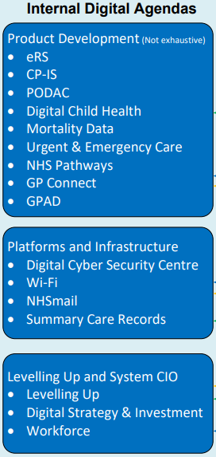
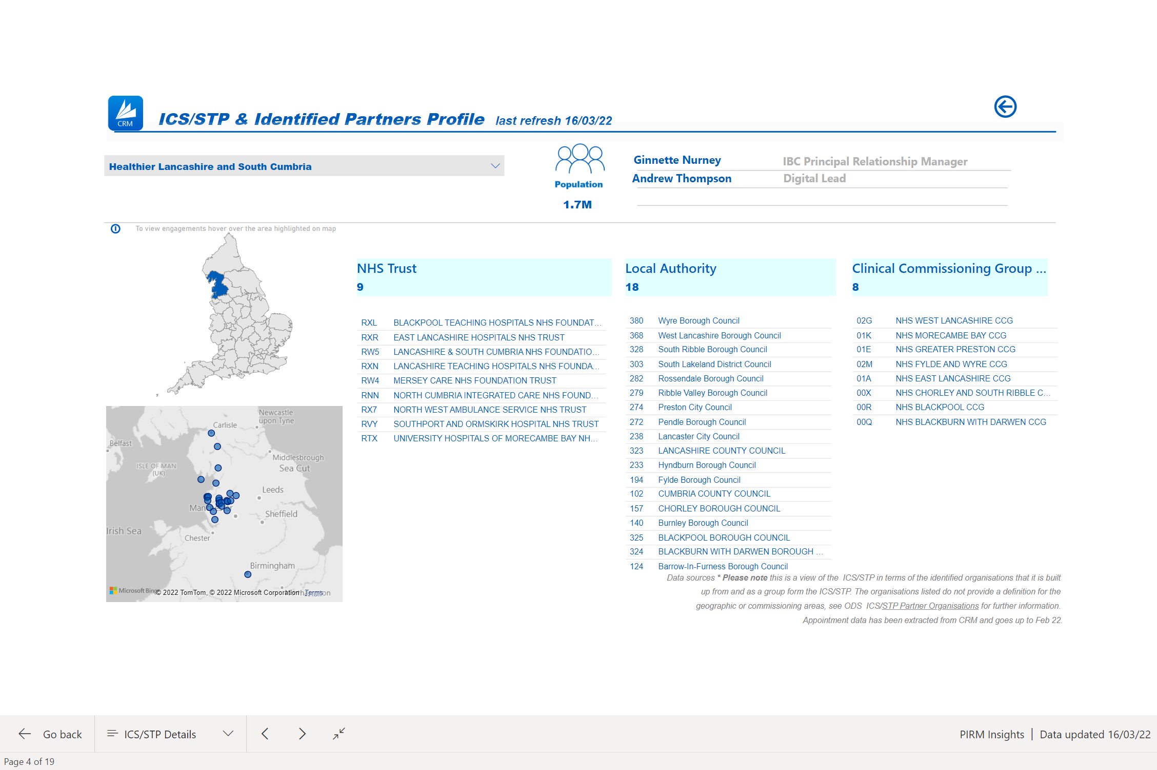
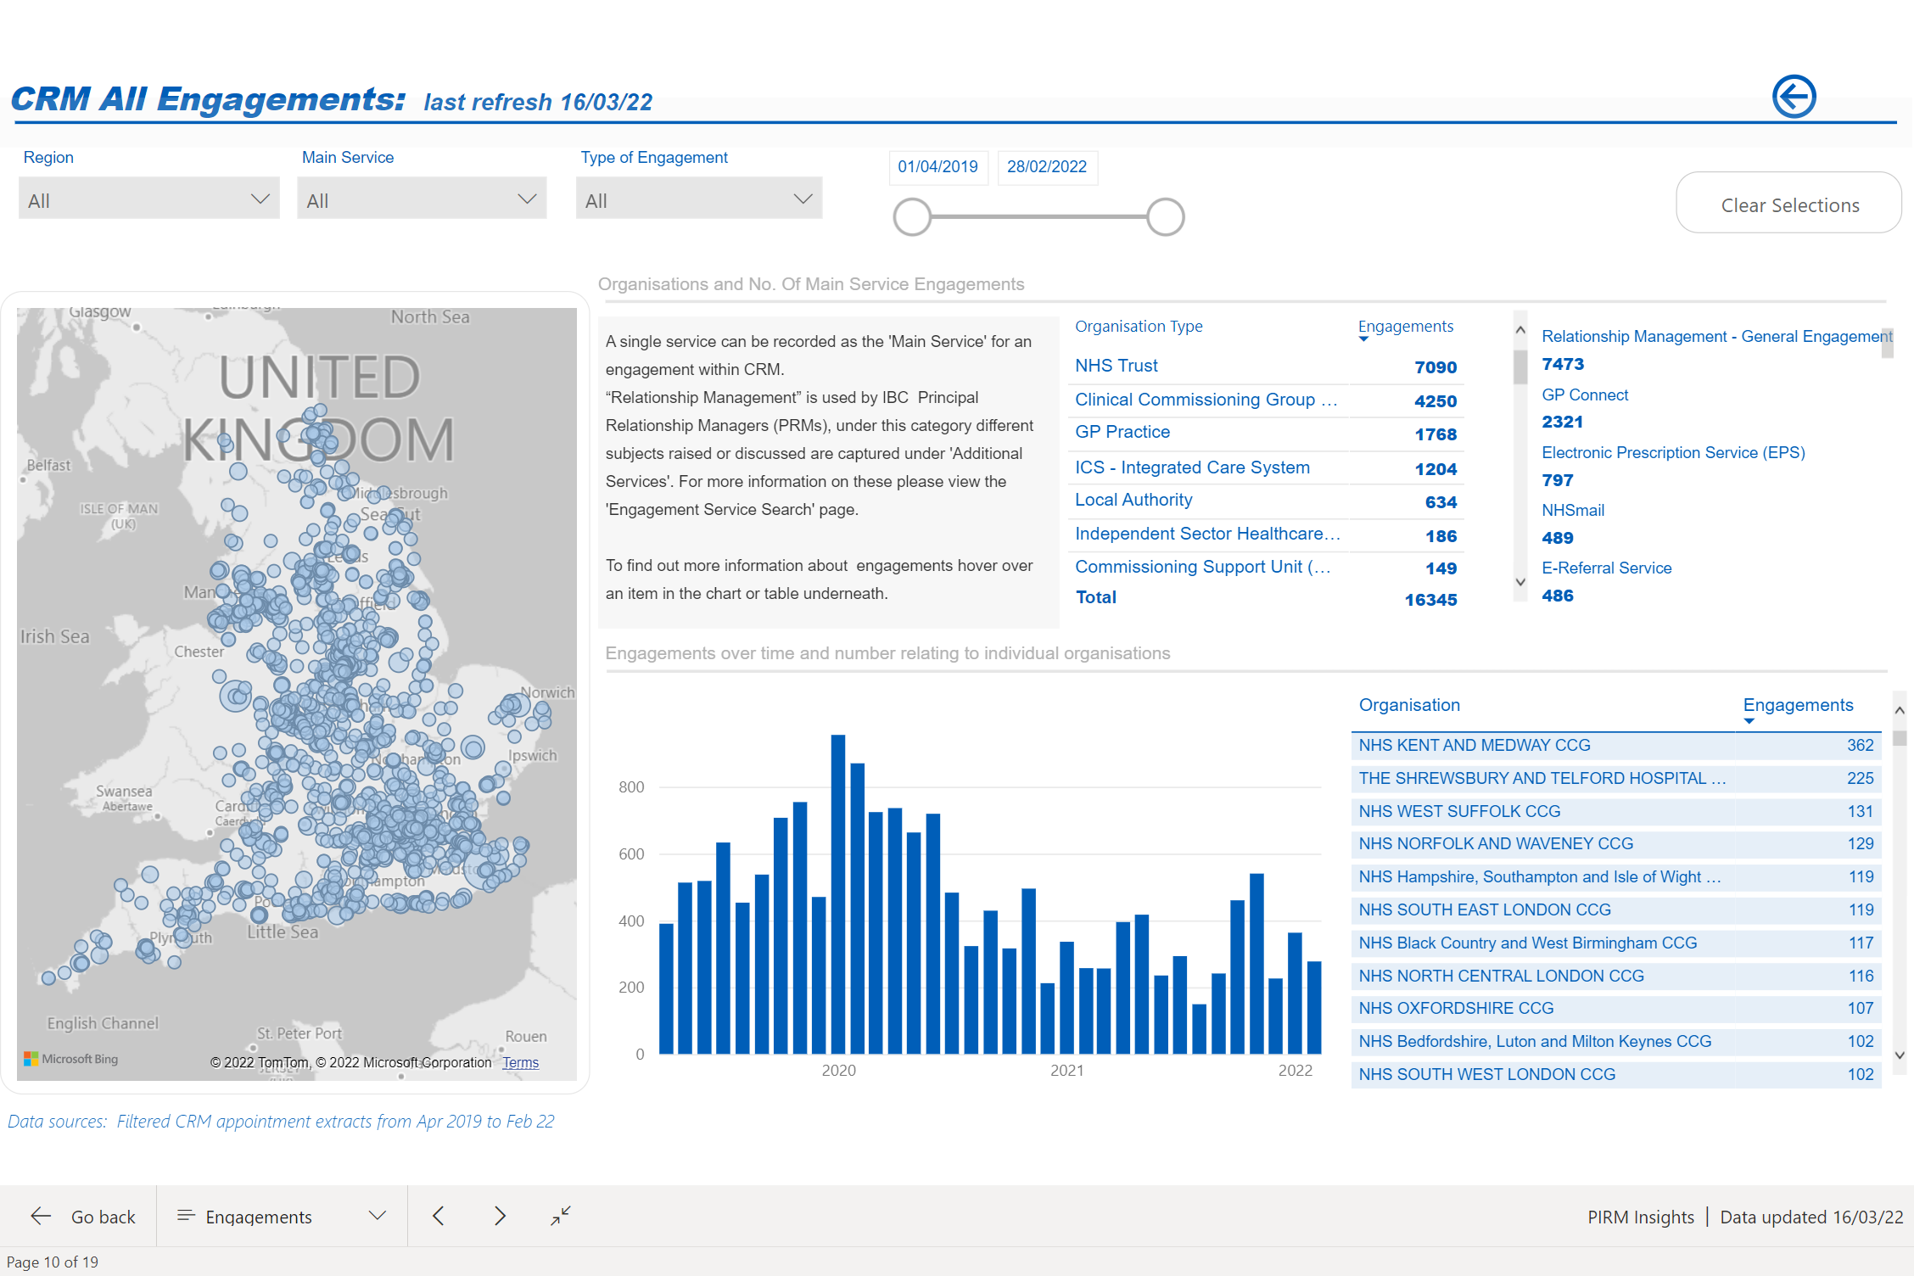
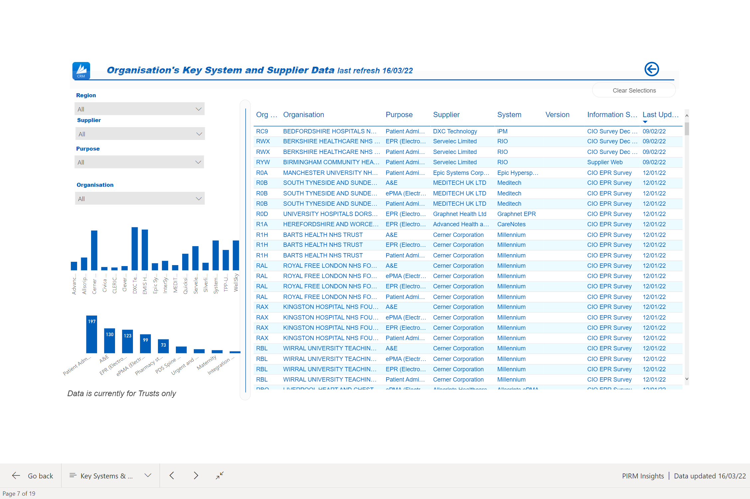
Digital Partnering Offer
ICSs x42
Transformation Directorate System Intelligence
Provides frontline intelligence on digital plans for national strategic decision making
Maintains and analyses supplier and system intelligence to influence and react to new standards, cyber threats, insolvencies and future market entrants and convergence
Provides feedback on current and new requirements for products and services
Sound business validation of proposed new National Initiatives
ICS / Service Provider
Digital Partnering Team
ICS / Service Provider
Offer to Internal Programmes, Products and Services
Manage Digital relationships with ICS Leads and System CIOs
Product Placement of National Products Services & Standards into ICS Strategy
Communication of National Services in the pipeline to prevent unnecessary local investment
Connecting programmes and Subject Matter Experts with ICS Digital Strategy Teams
Coordination of National Support offerings via a Service Catalogue
Coordination of System information requests and digital data collection
ICS / Service Provider
ICS / Service Provider
Offer to ICS Digital Leaders and System CIOs
Providing a single accountable point of contact for information requests and service issues
Presenting the voice of the ICS and customers back into Products and Programmes
Presenting new frontline business requests into National Strategy teams
Providing intelligence on potential pilot and scaling opportunities of local solutions
Early visibility and influence over proposed National Initiatives
ICS / Service Provider
Management Information Supplier and System Dashboards
Notes:
The model itself will provide different offerings depending on the Stakeholder need, so for CIO and ICS Digital Leaders, the Digital Partners will be a single point of contact and accountability, they will provide transparency of National Offerings both current and in development and most importantly they will act as the Strategic voice of the customer.
For Programmes the model will offer timely and reliable access to the right stakeholders, it will provide a better understanding of customer perception of their products and will highlight opportunities for piloting and collaboration with the front line. In addition programmes will have access to implementation services that can deliver efficiently and at pace because of the commitment and coordination with ICSs, reducing overall programme costs.
For the wider business, the model will provide the much needed insight on the digital priorities of the system, understand the supplier landscape and the impacts of our decisions up them whilst also providing visibility of where we are supporting and where we are not, to be able to measure the impact of our engagement.

Slide 6
Digital Partnering Benefits
Time savings for Digital Leaders – min 3660 hours
Model and role requested and welcomed by the System
Reduced National effort “engaging” and “selling”
Increase pace of adoption
Help realise the local Return on Investment from National Technologies
Reduce internal stakeholder management
Increase access to local system contacts, intelligence and data
Reduce data gathering efforts and burden on frontline
Data for strategic decision making
Notes:
Even using conservative estimates that the Digital Partnering role would save CIOs and ICS Digital Leaders 30 minutes a week searching for information, National investment would easily save the front line over 3600 hours per year. If you were to also include the time savings across their local Digital Team members that routinely reach out to us for information, these front-line time savings increase significantly.
The Digital Partner role closely aligns to the Principal Relationship Manager role that currently represents and provides product placement of the NHS Digital Portfolio to all CIOs. This role is warmly welcomed by Digital Leaders who have reflected through 121’s, the weekly CIO Touchbase meetings and ICS Deep Dive, that they want to see even greater coordination of the digital agenda and priorities and would value real collaboration in the develop of their ICS Digital Strategies.
Partnering closely with Digital Leaders on the development and implementation of their digital plans will also reduce National effort in “engaging” and “selling” the specific benefits of products and services
Close Partnering should also realise an increase in the pace of change and adoption with ever greater executive buy-in, mandate and direction from System Leaders.
Although difficult to measure, the business should see a reduction in internal stakeholder management costs across the portfolio by providing access to far greater levels of local system contacts, intelligence and data allowing the Transformation Directorate to remove significant amounts of data gathering effort internally as well as request on the front line.
Time spent collecting and maintaining contacts will be undertaken by those engaging across the system and we will also be able remove expenditure on 3rd party information services such as Digital Health Intelligence (£16k per annum).
Strategy and Decision makers will be provided with up to date, data on the frontline systems in use and direction of travel and convergence, making National decision making quicker and more accurate.
Lastly this data can also feed Live Services to support the management of National Supplier issues, insolvencies and planning for National System upgrades. ICS have also requested that we share their data across organisations to better manage such things as the supplier community.

Slide 7
Questions?

Slide 8
Questions?
Presented by: Oliver Christie Date: 13th May 2022

